Slide 1
Singly Linked List: Concepts and implementation
Dr. Rupam Bhattacharya

Slide 2
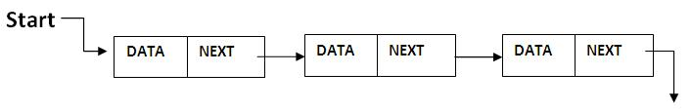
Singly linked list: recapitulation
Linked list is dynamic.
In linked list, we can store data in a node.
In each node of a singly linked list, there will be data part and a single pointer to store the address the next node.
NOTE:- The pointer of a node is to store the address of the entire next node, not to store the address of the data.

Slide 3
Singly linked list: recapitulation
Contiguous memory allocation is not needed.
Frequent insertion and deletion is possible.
We can insert at and delete from any position of singly linked list.

Slide 4
Singly linked list: Basic operations
Adding a node at beginning.
Adding a node after a given node.
Adding a node before a given node.
Deletion of node from any position.
Display content of each node.
Counting number of nodes.
…..and so on

Slide 5
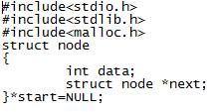
Singly linked list: Programming
Structure of a node:
In a node, there are two parts, one data part,
And a pointer part to point next node.
*start is a pointer of type node to store address of the first node.

Slide 6
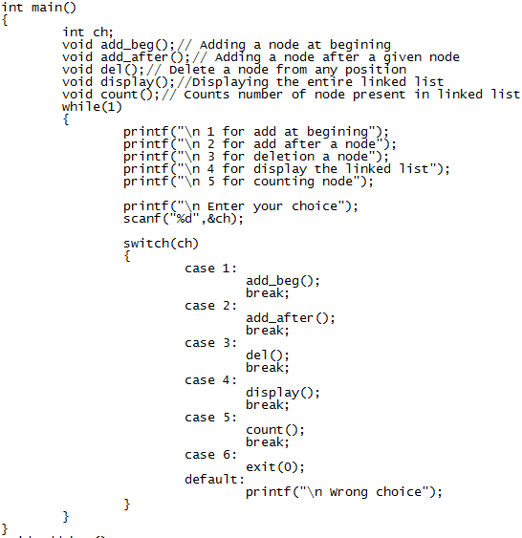
Singly linked list: Programming
Main function is common like our previous programs:

Slide 7

Singly linked list: Programming
Add_beg() function to add a node at beginning.
Using malloc, we are creating a node dynamically.
Then taking data from user and
Storing that data in data part of new node(tmp)

Slide 8

Singly linked list: Programming
Add_beg() function to add a node at beginning.
If start is NULL, then this will the first node, so next pointer will be NULL.
Otherwise, tmp will be the first node, so next of tmp will point current start node.
At last, start will point tmp, as tmp is now the first node.

Slide 9
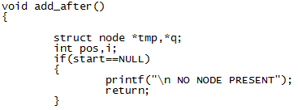
Singly linked list: Programming
Add_after() function to add a node after a node.
If start is NULL, implies there is no node, so this function will not work.
If start is not NULL, then we can proceed for adding the node after a given node.

Slide 10
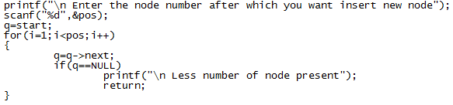
Singly linked list: Programming
Add_after() function to add a node after a node.
Inside loop, we are moving q pointer so that it can point to the node after which we wish to insert.
But, meanwhile, if q is NULL, that implies “pos” number of node actually not present.
So, if, “pos” is valid, q pointer will point to that node after which we wish to insert.

Slide 11

Singly linked list: Programming
Add_after() function to add a node after a node.
Creating node using malloc, taking data from user.
tmp node will be placed after node pointed by q, so next of tmp will point to previous next node of q.
Now, next of q will point to tmp as tmp node is added after node pointed by q.

Slide 12
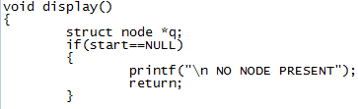
Singly linked list: Programming
display() function to show all elements of linked list.
If start is NULL, implies there is no node present.
Then we have nothing to display.
Otherwise, we will display all data from first to last node.

Slide 13
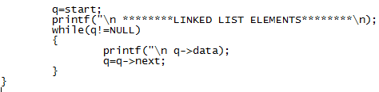
Singly linked list: Programming
display() function to show all elements of linked list.
q pointer is pointing to start.
So display will starts from first node, it will move up to last node (see the while condition).
Then we are showing data part and moving q pointer towards end.

Slide 14
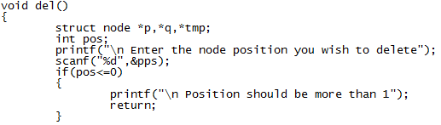
Singly linked list: Programming
del() function to delete a node from linked list.
We are taking the node to be deleted.
If position is less or equal to zero, implies wrong input.

Slide 15

Singly linked list: Programming
del() function to delete a node from linked list.
pos=1 implies , first node to be deleted.
Storing address of first node in tmp and setting start to point to next node
Then deleting first node by free();

Slide 16
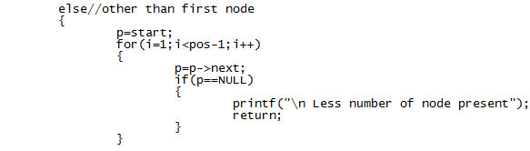
Singly linked list: Programming
del() function to delete a node from linked list.
If it is other than first node then…
Like add_after(), running a loop to point to the node after which deletion will take place.

Slide 17

Singly linked list: Programming
del() function to delete a node from linked list.
p pointer is pointing to node before deleted node, q pointer is pointing to node to be deleted.
Next of p pointer is set to point next node pointed by q.
Then, delete q using free() function.

Slide 18
Singly linked list: Programming
count() function to count number of nodes present.
This function will be like display() function.
Just don’t display data, use a counter inside the while(q!=NULL) of display() function.

Slide 19
Singly linked list: Programming
There can be other operations also on Linked list, such as:
Add a node before a node.
Check how many odd or even data present in linked list.
Searching a particular data from linked list using linear search.
and so on…..
You can do above operations if you understood functions written in this tutorial.

Slide 20
Thank you all

